Slide 1


Slide 2
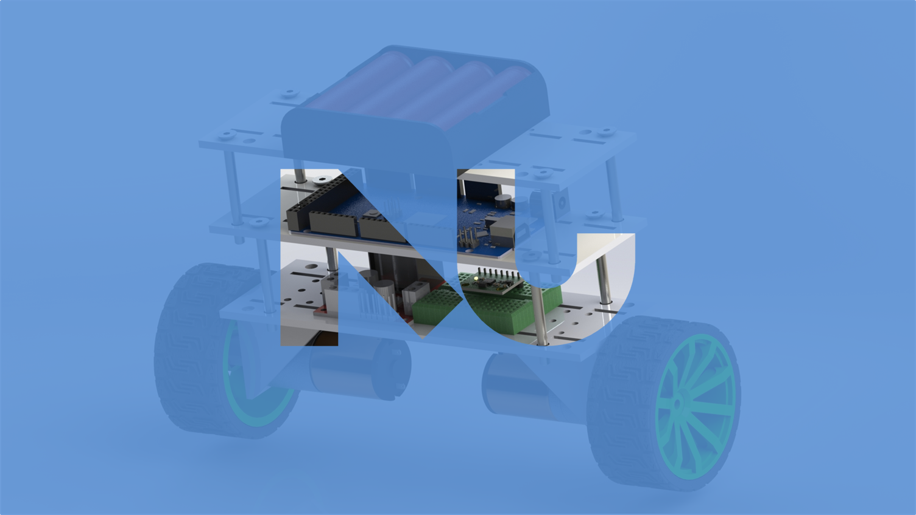

Slide 3
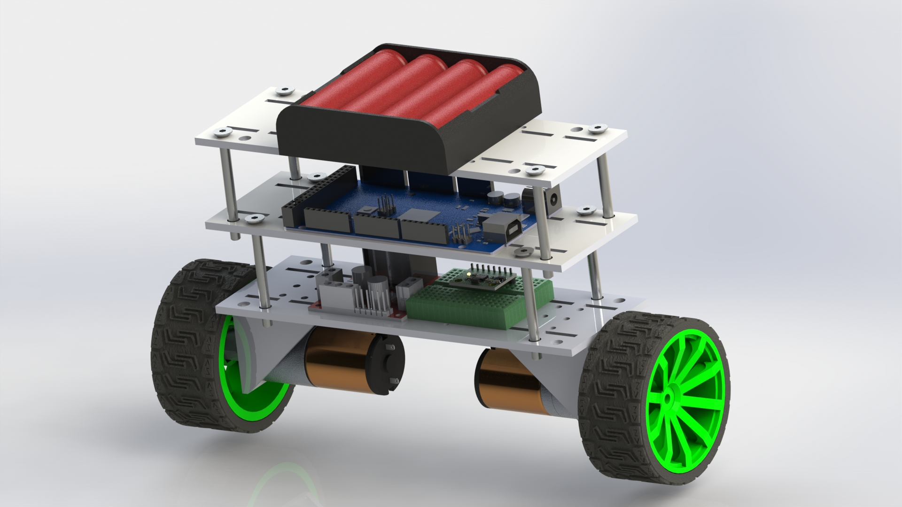
SELF-BALANCING ROBOT
MICROCONTROLERS
Dr. Mahmoud El Samanty | Eng. Hossam Hassan
Berit Adina Händel 171018
Gabriel de Brito Silva 171020
Hedaya Ali 171103
Mohd Saiful Akmal Bin Razali 171021

Slide 4
OBJECTIVES
To design a two-wheeled self-balancing robot.
To fabricate a two-wheeled self-balancing robot.
To demonstrate a two-wheeled self-balancing robot that can stay upright.

Slide 5


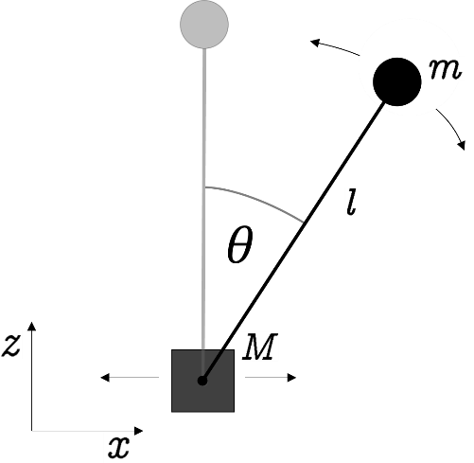
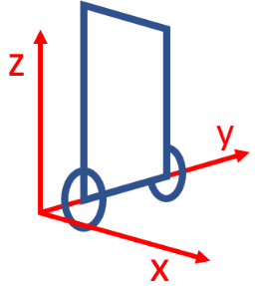
Inverted Pendulum
Theoretical
Analysis
we assume that the robot is mainly unstable in rotation around the wheel axis. Therefore, the model becomes 2-diminsional (z- and x-axis) and 2-DOF (position on x-axis and inclination angle).
The pendulum consists of a mass, which is connected to the base’s mass. The pendulum can freely rotate around the joint point and the base’s mass can be move along the x-axis

Slide 6
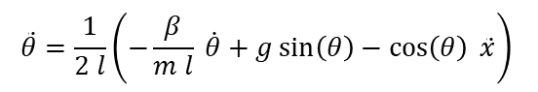
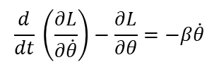
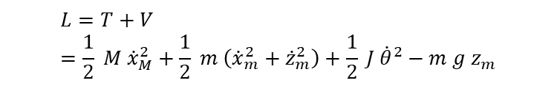
Inverted Pendulum
Theoretical
Analysis
$$L=T+V=\frac{1}{2} M {\dot{x}}_{M}^{2}+\frac{1}{2} m \left({\dot{x}}_{m}^{2}+{\dot{z}}_{m}^{2}\right)+\frac{1}{2} J {\dot{θ}}^{2}−m g z_{m}$$
kin. energy of mass M
kin. energy of mass m
rot. energy of mass m
pot. energy of mass m
$$\frac{d}{dt} \left(\frac{∂L}{∂\dot{θ}}\right)−\frac{∂L}{∂θ}=−β\dot{θ}$$
damping of the pendulum
$$\ddot{θ}=\frac{1}{2 l}\left(−\frac{β}{m l} \dot{θ}+g\sin\left(θ\right)−\cos\left(θ\right) \ddot{x}\right)$$

Slide 7
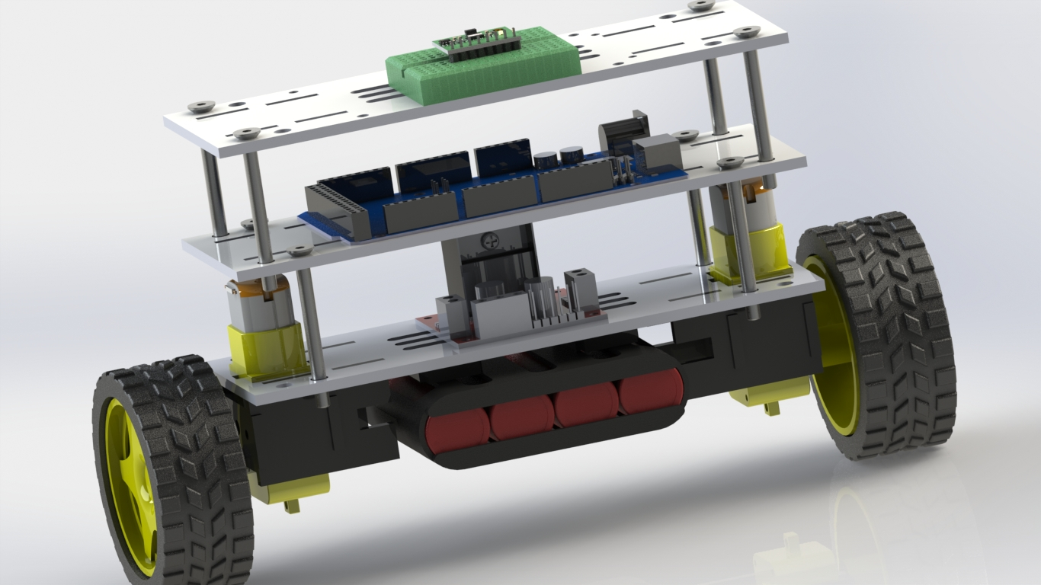
FIRST DESIGN

Slide 8
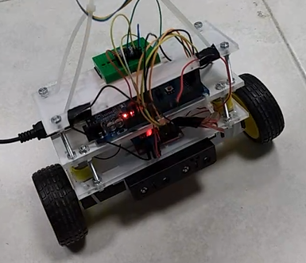
FIRST DESIGN

Slide 9
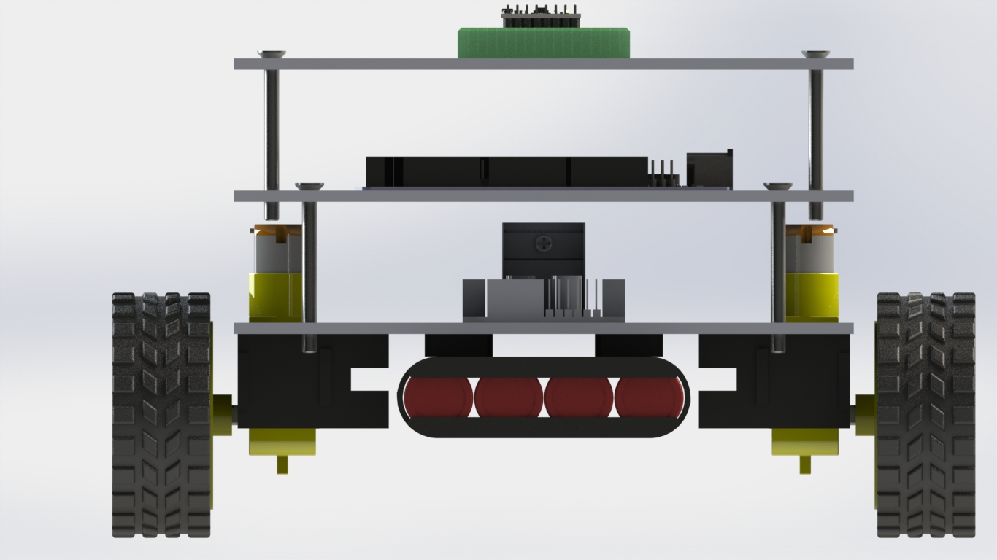
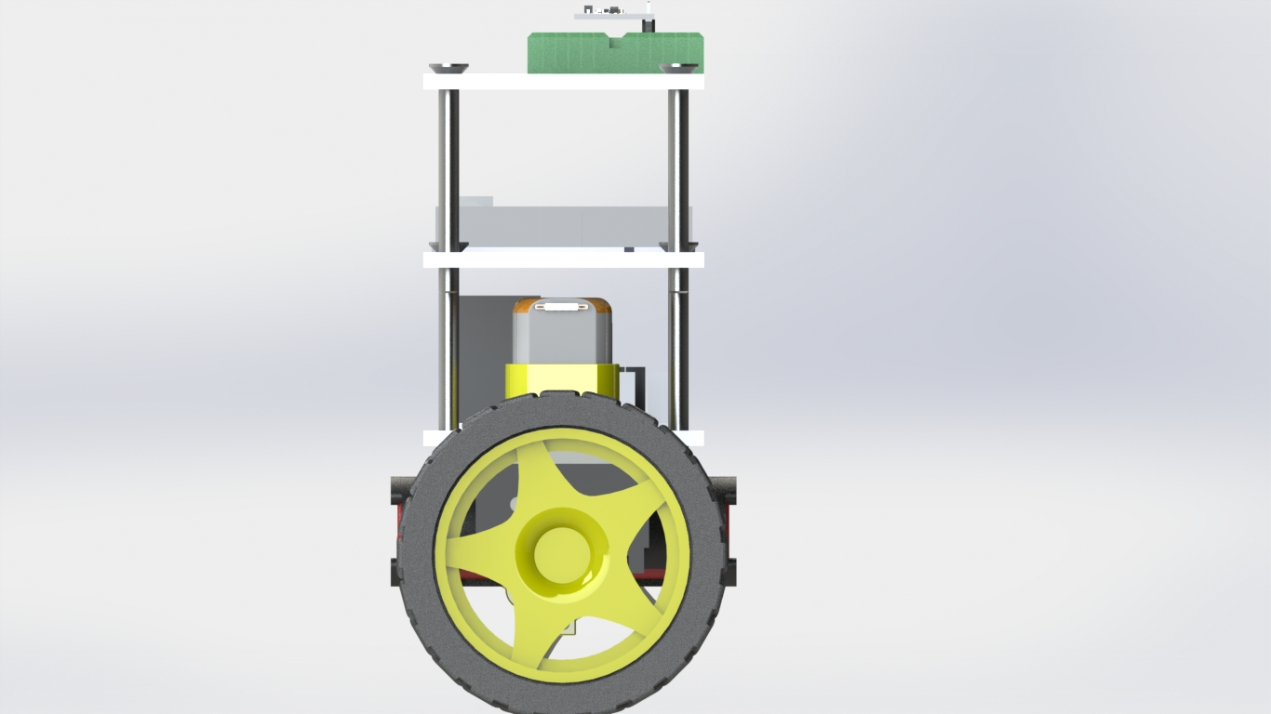
NOME DO APRESENTADOR

Slide 10
NOME DO APRESENTADOR
The battery is located at the below of the chassis of our self-balancing robot.
However, we faced a difficulty whereby our self-balancing robot is not able to balance very well due to the center of mass is located below the pivot point which make our self-balance robot difficult to balance itself.
Therefore, after some discussion we decided to change our design.

Slide 11
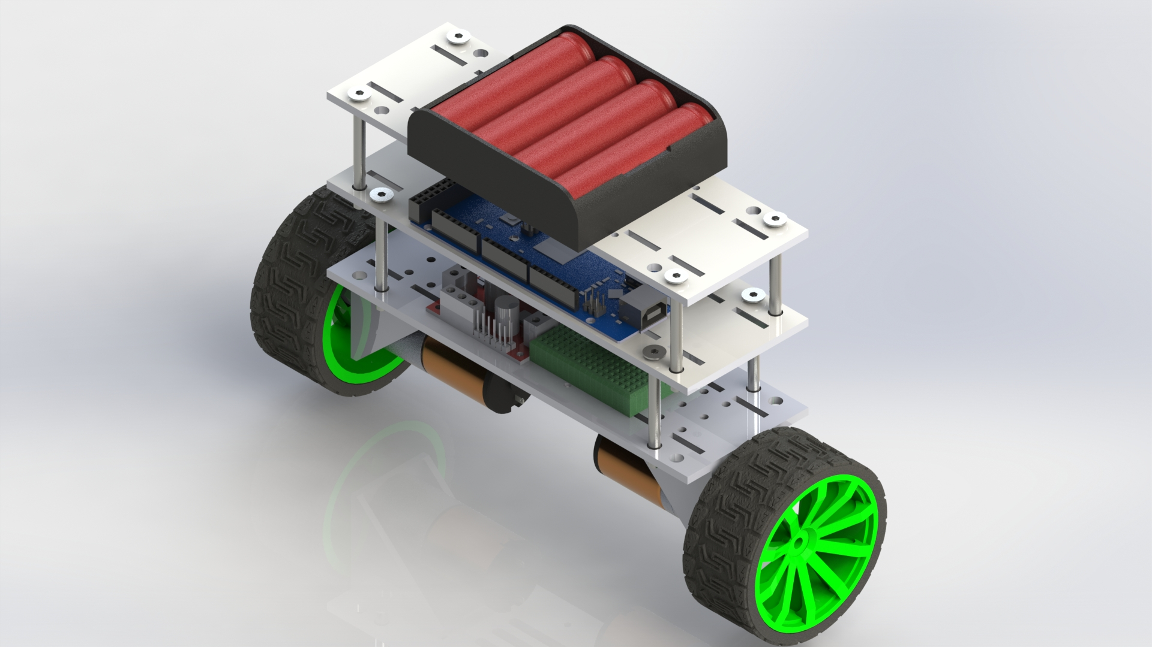
REWORKED DESIGN

Slide 12
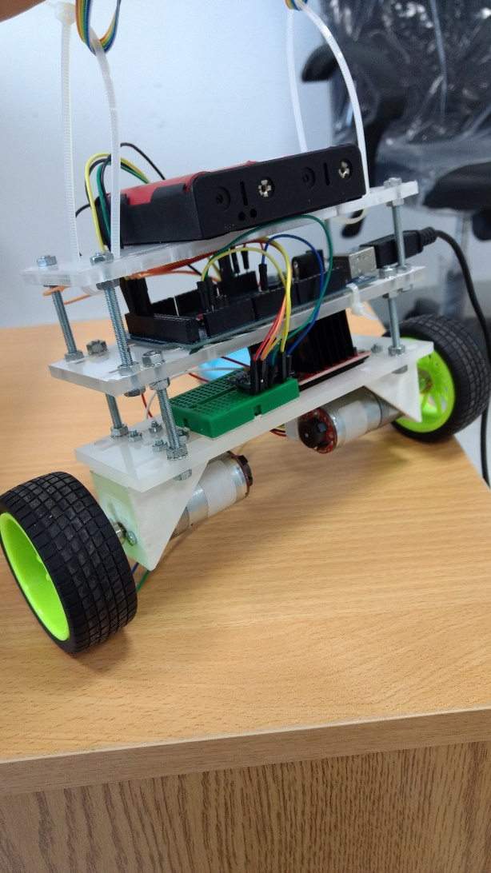
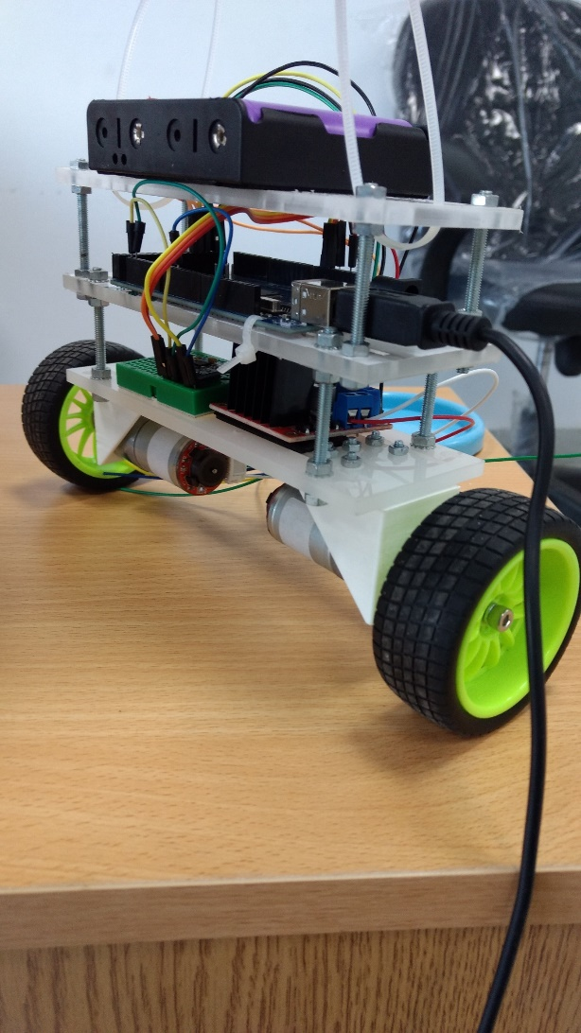
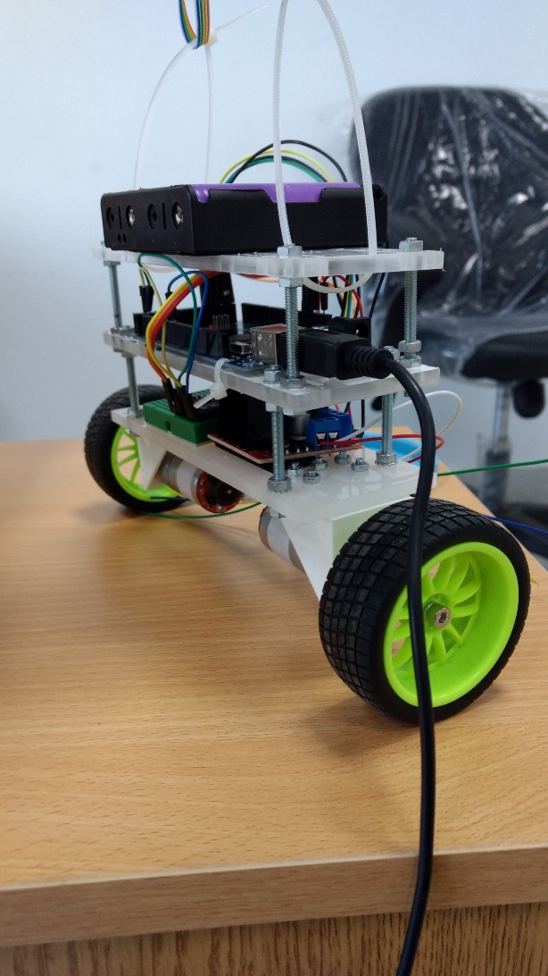
REWORKED DESIGN

Slide 13
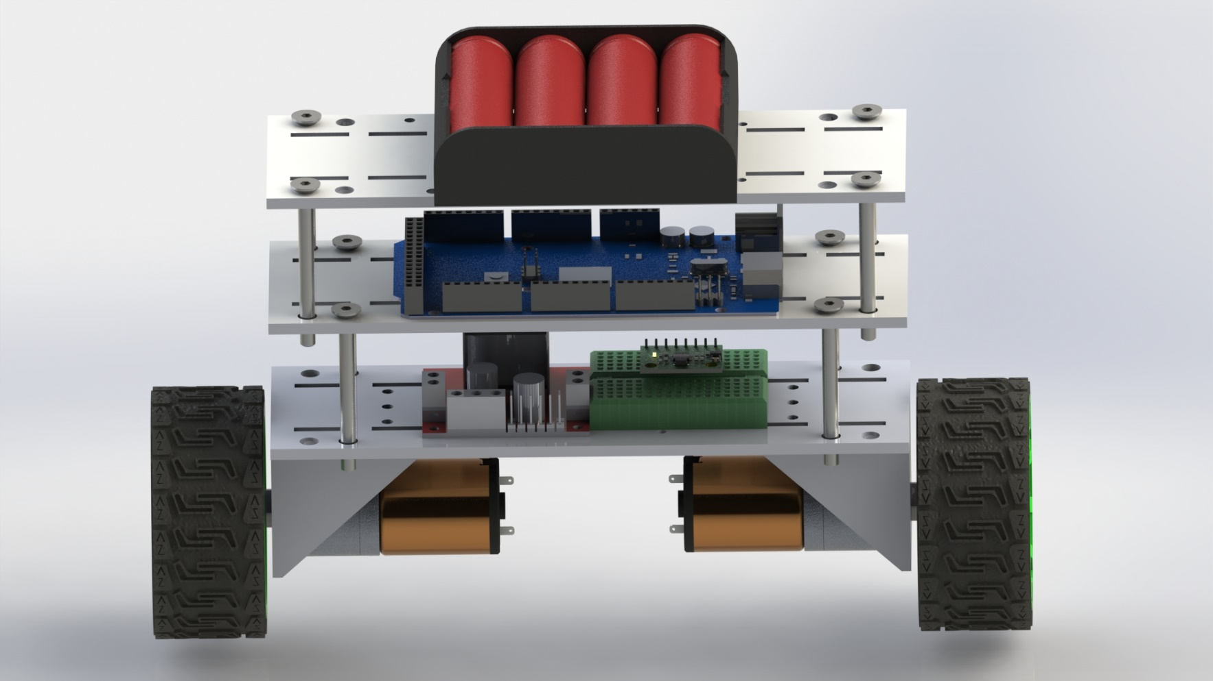
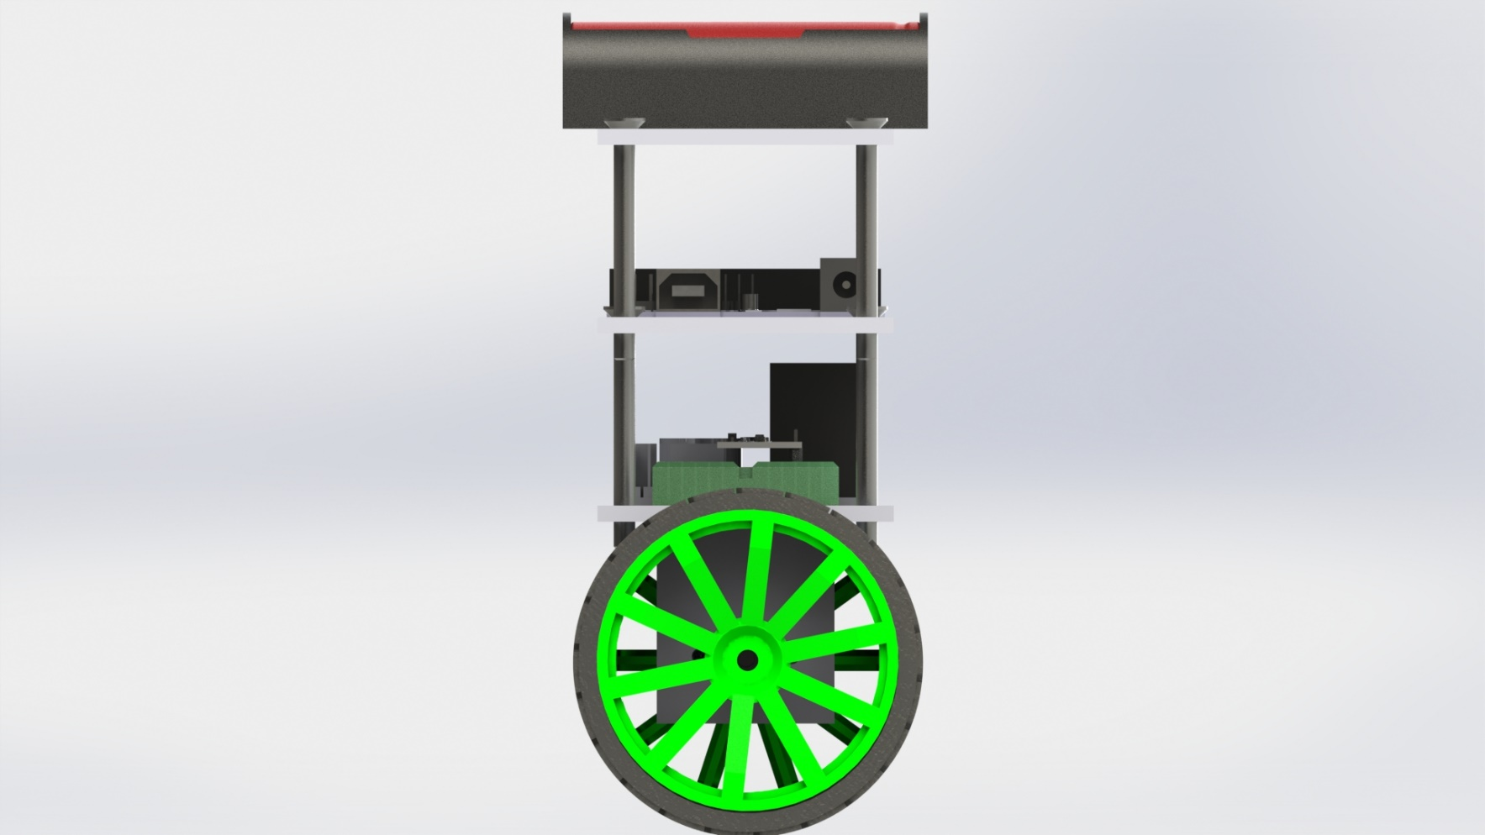
NOME DO APRESENTADOR

Slide 14
The reworked design of this self-balancing robot is shown below. The modular design allowed the layers to be adjusted as needed.
The battery is the component with the greatest value of density. The placement of the battery at the top is to make sure that the centre of mass is located above the pivot point.
All the other components are placed close to each other to avoid interference that comes with longer wires.
NOME DO APRESENTADOR

Slide 15

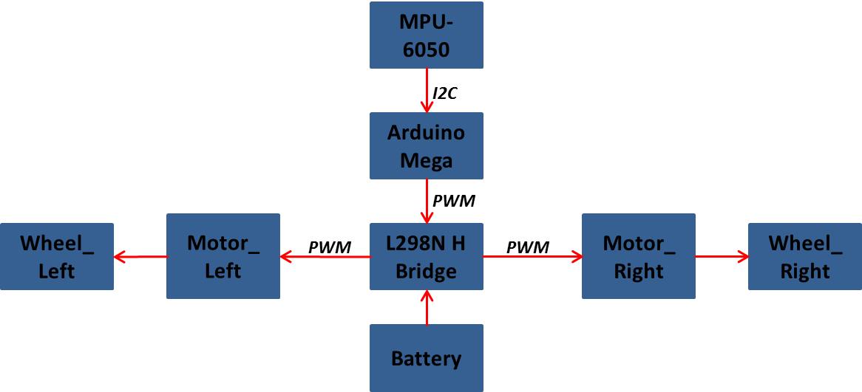
Components and connections

Slide 16
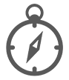
Components and connections
Arduino Mega will read a raw data from the measurement sub-system which in this case is MPU-6050.
Arduino Mega reads raw data from the measurement sub-system and sends PWM signals to the motor driver to be converted to mechanical motion.

Slide 17
Components and connections
When fresh IMU data is received, the MPU-6050 filters out sensor noise, and then fuse the data from the two sensors together to produce a single reading of tilt.
Once the current tilt is known, the MPU-6050 calculates the error from the desired tilt, in this case the vertical, and then uses PID to control the PWM output to the motor driver sub-system.

Slide 18
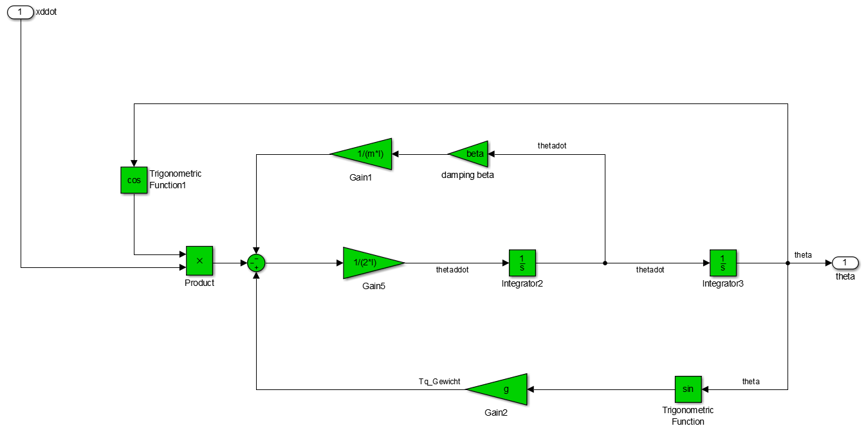
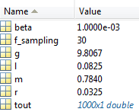
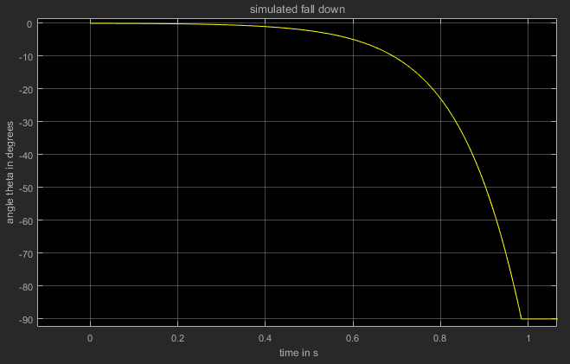
SIMULATION

Slide 19
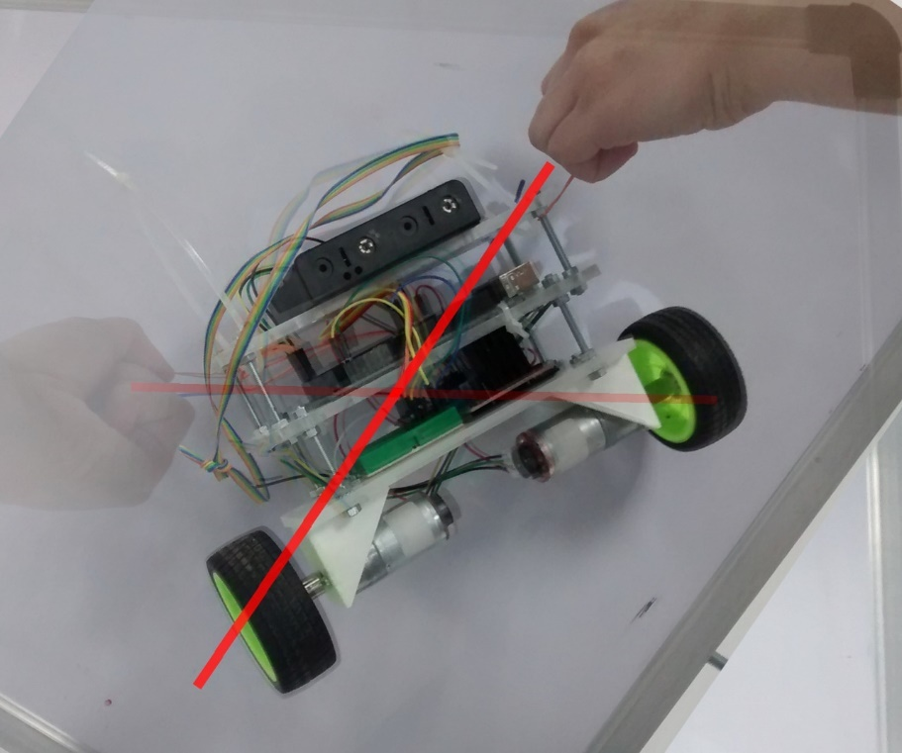
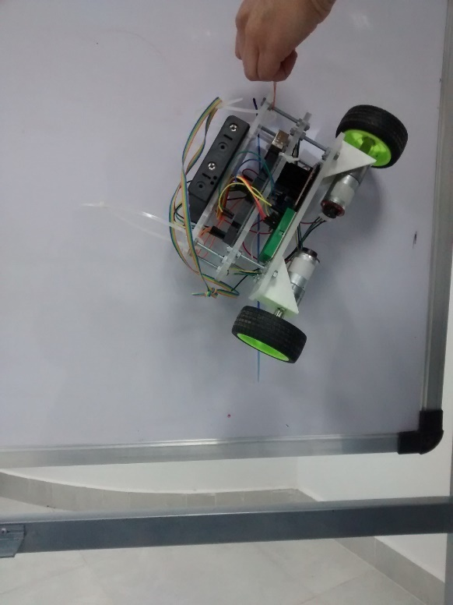
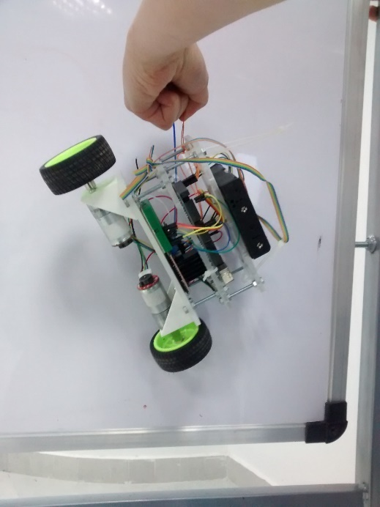
SIMULATION

Slide 20
SIMULATION

Slide 21
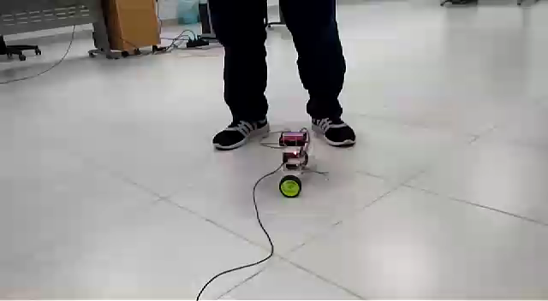
demonstration

Slide 22



THANK YOU
Erasmus Mundus Students (2017-2019)
Master in Mechatronics and Micromechatronics Systems
Nile University - Egypt
Fall/2017

